Slide 1
Comprehensive
Tax Planning in 2017
For Retirees Living in Canada

Slide 2
About the Speaker…
Kurt Rosentreter
CPA, CA, CFP, CLU, TEP, FMA, CIMA, FCSI, CIM
CPA Canada course instructor for the last ten years (Ontario, B.C., Manitoba).
Twenty-five years of personal finance industry experience.
Past co-founder of the $2 Billion Investment Counsel practice at one of Canada’s Big Four CA Firms.
National best selling author of seven personal finance books.
Senior Financial Advisor, Manulife Securities Incorporated.
Certified Financial Planner, Manulife Securities Insurance Inc.
Instructor / Speaker to more than 500 audiences on matters of personal finance.
Regular commentator on money for CBC, CTV, Globe, Post, Star, various radio and magazines.
Regular contributor as an expert in the Financial Facelift column for The Globe and Mail.
www.KurtismyCFO.com

Slide 3
Agenda
Tax Planning and Individuals
Tax Planning and Business Owners
Tax Planning and Investors
Tax Planning and Your Estate

Slide 4
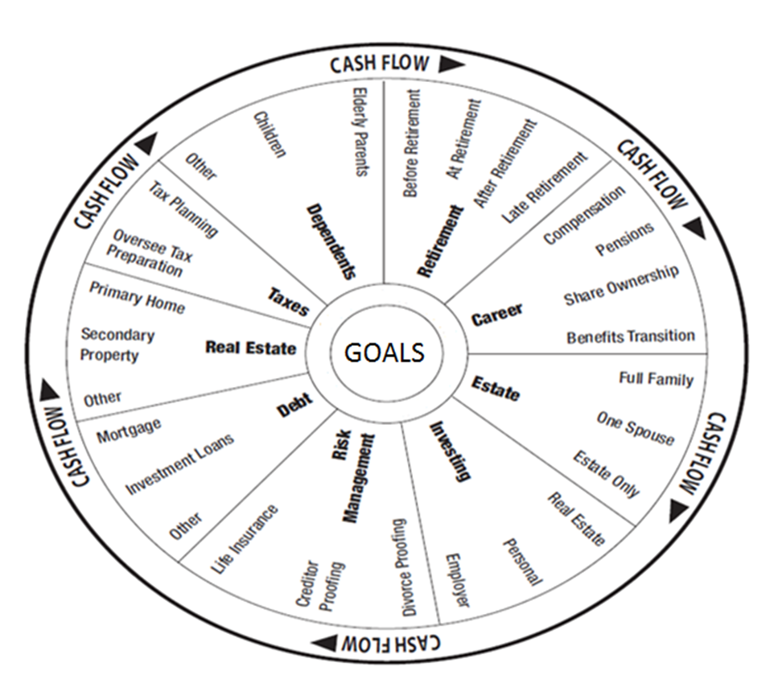
Everyone’s Financial “Big Picture”

Slide 5
Tax Planning and Retired Individuals

Slide 6
Tax Planning and Retired Individuals
RRSP Contribution Strategy
RRSP Withdrawal Strategy
Conversion to RRIF Strategy
Annual Income Planning to Minimize Average Tax Rates
Pension Income Splitting
Pension Credit
Minimizing OAS Clawback
Tax Installments

Slide 7
Tax Planning and Retired Individuals
Charitable Giving Strategy
Home Accessibility Credit, Caregiver Credit, Disability Tax Credit, Medical costs
Spousal Loans
Giving up Canadian residence
Giving assets to children and grandchildren

Slide 8
Tax Planning and Business Owners

Slide 9
Tax Planning and Business Owners
To incorporate or not
  Small business tax rate / deferral of future taxes
  Income splitting with family
  QSBC gains exemption on sale ($800,000+)
July 2017 Liberal Government proposed tax changes
Salary vs. Dividends
Home Office
Meals and Entertainment, Travel costs tax deductible
Health spending account
Individual pension plan
Corporate owned life insurance

Slide 10
Tax Planning and Investors

Slide 11
Tax Planning and Investors
Six Dimensions of Tax Smart Investing
  Taxation and family members provides opportunities to save tax.
  Taxation and investment asset types provides opportunities
  Taxation and investment income types provides opportunities
  Taxation and fee types provide opportunities
  Taxation and legal ownership provides opportunities
  Taxation and foreign held assets provides opportunities

Slide 12
Tax Planning and Investors
QSBC (Qualified small business gains exemption)
ABIL
Rental properties
Principal residence exemption strategy
Positioning Canadian source dividends
Positioning interest income
Investment holding companies
  Good vs. Bad
Annuities
Mutual funds and pooled funds – tax disaster
Tax deductible investment fees
Foreign tax pitfalls
Portfolio Annual Turnover

Slide 13
Tax Planning and Your Estate

Slide 14
Tax Planning and Your Estate
While you are alive:
  Tax smart Wills
  Two maybe three Wills
  Know your tax bill at death
    Use assets to pay tax bill
    Use life insurance to pay tax bill
    Minimize tax bill during life.
  Joint ownership good and bad
  Gifting good and bad
  Beneficiary designations

Slide 15
Tax Planning and Your Estate
While you are alive:
  U.S. Estate Tax Planning
  Spousal Trusts
  Testamentary Trusts
  Safety Deposit Box
  Charitable foundations
  Family Cottage Strategy
  Read your Will out loud

Slide 16
Everyone’s Financial “Big Picture”

Slide 17
Questions and Answers

Slide 18
Disclaimer
The opinions expressed are those of the author and may not necessarily reflect those of:
Manulife Securities Incorporated or
Manulife Securities Insurance Inc.
Manulife Securities Incorporated is a member of the Canadian Investor Protection Fund

Slide 19



How to Contact Kurt Rosentreter
Thank you for attending today!
Kurt Rosentreter, CPA, CA, CFP, CLU, TEP, FMA, CIMA, FCSI, CIM
Senior Financial Advisor and Associate Portfolio Manager, Manulife Securities Incorporated
Certified Financial Planner and Life Insurance Advisor, Manulife Securities Insurance Inc.
302 – 3 Church Street, Toronto, ON M5E 1M2
416.628.5761 Ext 230 Kurt.rosentreter@manulifesecurities.ca www.kurtismycfo.com
Follow Kurt on:
www.facebook.com/kurtismycfo
www.linkedin.com/in/kurtrosentreter
@KurtRosentreter

